Slide 1
Web technologies
Theory Part

Slide 2

topics
Client/Server Model
Three tier Client/Server Arch.
P2P
Internet vs Web
WWW standards
NAT, DNS
URI, URL & URN
HTTP
Web Browser & Web Server
HTTP vs HTTPS

Slide 3
Software & website
Software (Applications):
Installed and run directly on your computer. All files and functionality are stored in your PC.
Websites:
Not installed on your computer. They are hosted on remote servers. Your computer accesses them through the internet by sending and receiving data via a web browser.

Slide 4
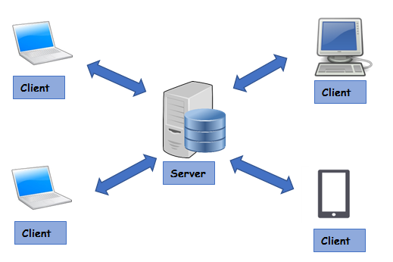
Client/server model
Client: Client is a device or software that requests data or services from a server over a network.
Example: Browsers, mobile apps, email clients.
Server: A server is a device or software that provides data or services in response to client requests.
Example: Web servers, database servers, file servers, DNS servers, DHCP servers.

Slide 5
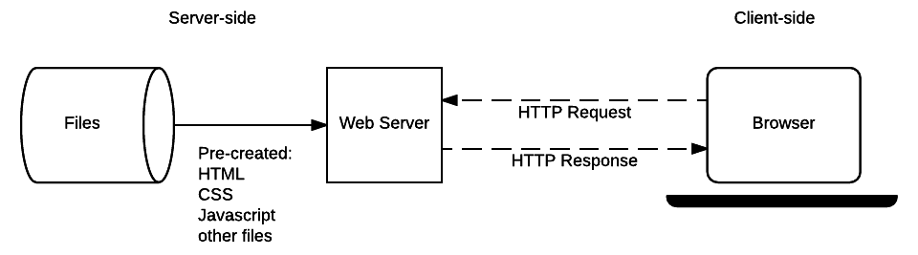
Client vs server
Client | Server
Sends HTTP requests | Sends HTTP response
Web browsers (Chrome, Opera, Firefox) | Web server (Apache, Nginx)
Access resources | Hosts resources

Slide 6
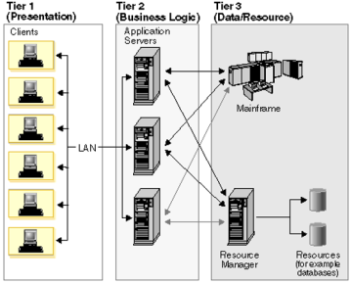
Three-tier client/server architecture
Presentation Tier (Frontend): Client-side UI/views
Business Logic Tier (Backend): Server-side control logic
Data Tier (Backend): Server-side data/resource from Database, storage.

Slide 7
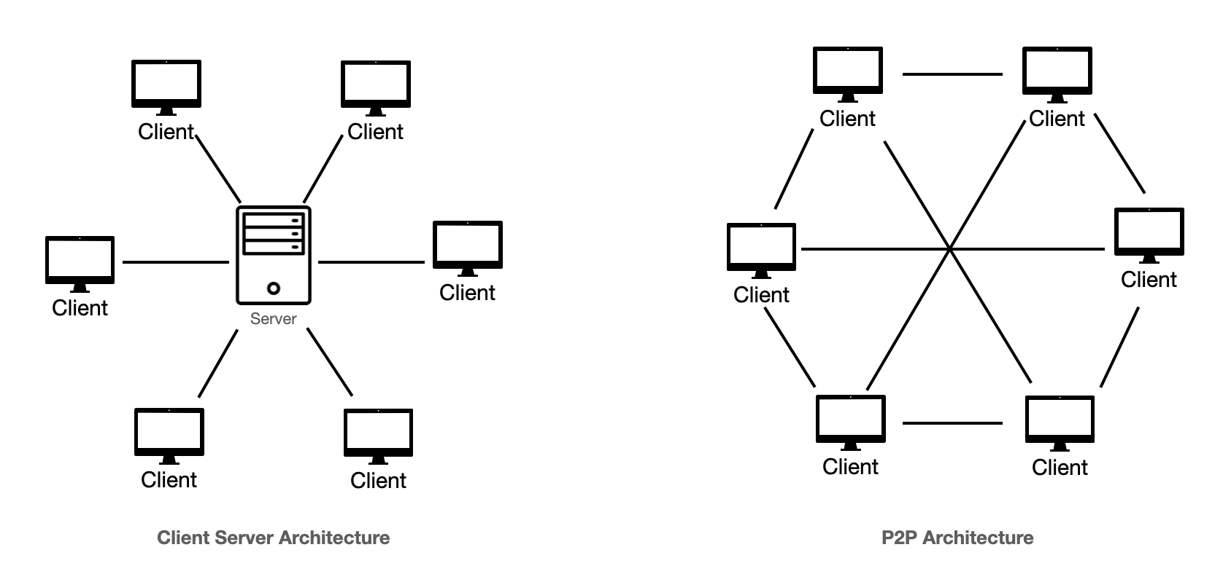
Peer To Peer Architecture (p2p)
No central server
All nodes are equal
Everyone is client, everyone is server
Data and resources are distributed (and encrypted) across all nodes
P2P Architecture
Client-Server Architecture

Slide 8
internet
PAN: Personal Area Network. Ex: Bluetooth devices
LAN: Large Area Network. Ex: Home, Office, Building.
MAN: Metropolitan Area Network. Ex: City or Large Campus
WAN: Wide Area Network. Ex: Country, Entire world
The Internet is a WAN that connects networks from all over the world, including PANs, LANs, and MANs.

Slide 9
World wide web or web
It was invented by Tim Berners-Lee in 1989.
A system/service of interlinked hypertext documents and multimedia content.
Internet | World Wide Web
The Internet is the global network of computers and devices. | The Web is a service that allows content stored on devices to be accessed and shared over the Internet.
Network Infrastructure | System of interlinked content and services

Slide 10
WWW Standards
W3C: World Wide Web Consortium. Standardized HTML, CSS, DOM etc.
IETF: Internet Engineering Task Force. Standardized HTTP, URI, TCP, IP etc.
ECMA International: Standardized ECMAscript (also known as JavaScript)

Slide 11
Network Address Translation (NAT)
Modifies IP Address in the headers of IP packets.
Conserves IP address
Enhances security
Resides in a Router or Firewall
Enables the use of both Private and Public IP address
Private IP address: Used within a Local network.
Public IP address: Used on the public Internet.

Slide 12
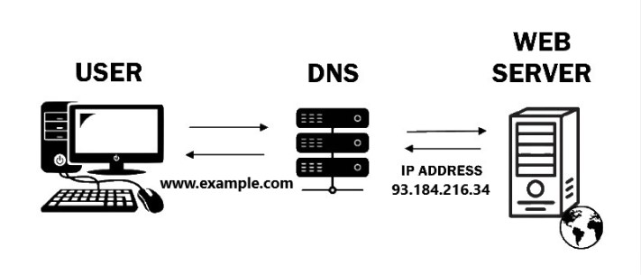
Domain name server (DNS)
Translates Domain Names to IP address
142.250.191.78 is the IP address for the domain name www.google.com
DNS servers store records that map domain names to IP addresses

Slide 13
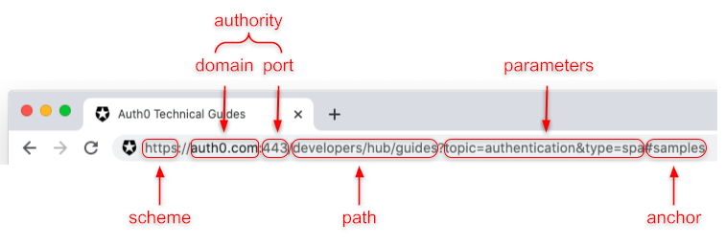
Uniform resource identifier (URI)
Example: http://en.wikipedia.org:80/wiki/URI?page=2&frame=1#history
80 is the Port number
Page=2 and frame=1 are Query Parameters
http is scheme
Path is the exact location of resource. Here, /wiki/URI
#history is called Fragment. It is the specific section of a webpage

Slide 14
Uri, url, urn
URI: Uniform Resource Identifier. Encompasses both URL and URN
URL: Uniform Resource Locator. Specifies the Location of a resource on the internet.
Ex: https://www.example.com/index.html
URN: Uniform Resource Name. Provides a unique name for a resource, but does not specify its location. Ex: urn:isbn:0451450523

Slide 15
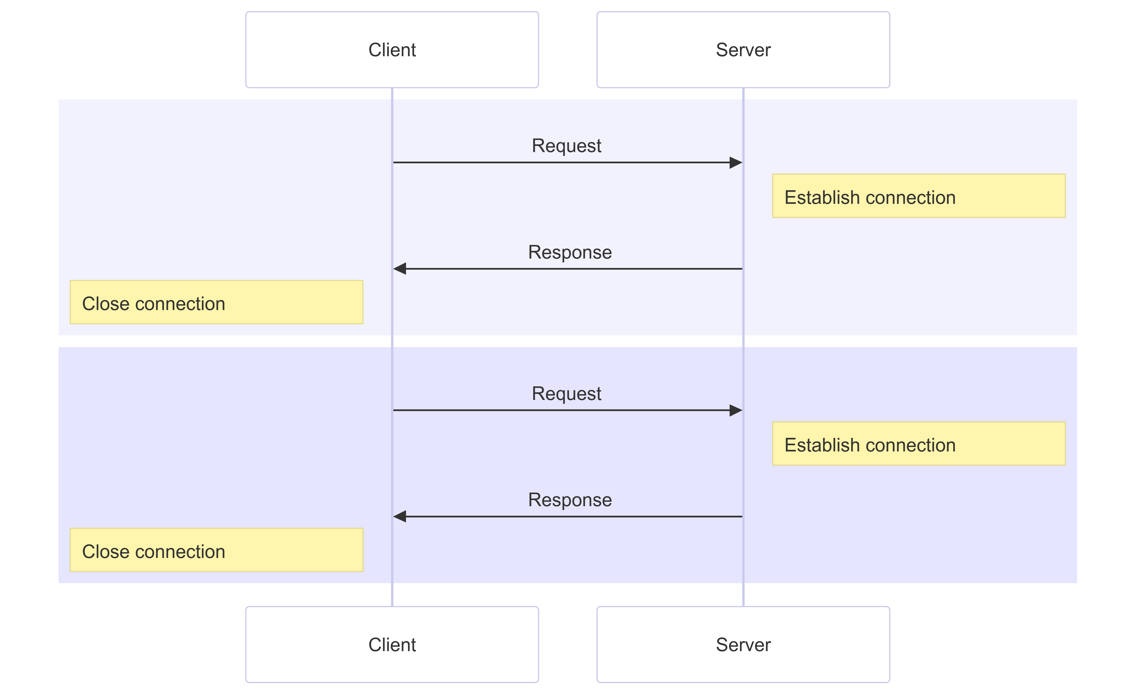
HTTP
Hyper Text Transfer Protocol
Communication between client and web servers is done by sending http Requests and receiving http Responses.
Stateless
Connectionless
Default port 80

Slide 16
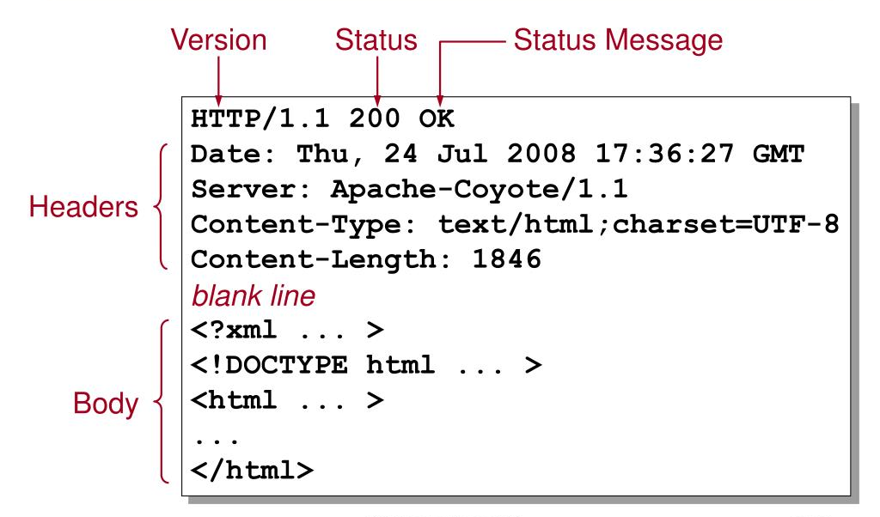
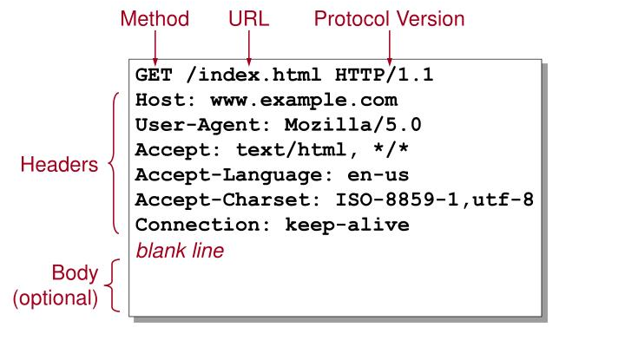
HTTP
HTTP Request
HTTP Response

Slide 17
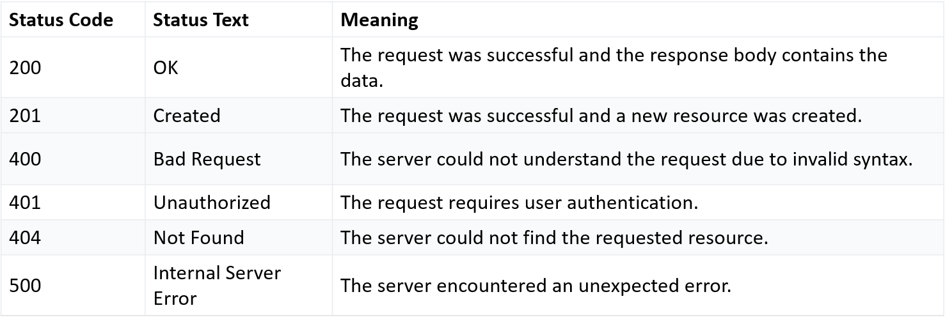
HTTP
The type of response messages:
1xx: Informational response
2xx: Success
3xx: Redirection
4xx: Client error
5xx: Server error

Slide 18
HTTP
GET: Retrieve data
POST: Create new data. Usually Form submission.
PUT: Updates the entire resource with new data. Create if not exists
DELETE: Remove data
PATCH: Updates only part of the resource. Assumes the resource already exists.
PUT | PATCH
Updates the entire resource with new data | Updates only part of the resource
Create data if does not exist | Does not create data if does not exist

Slide 19
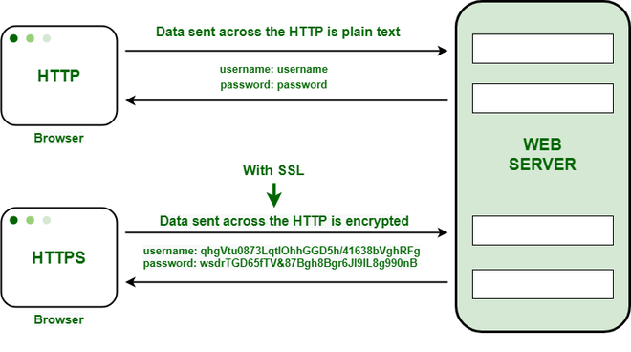
HTTP vs https (Hypertext Transfer Protocol Secure)
Default port 443 for HTTPS

Slide 20
Web Browser vs web server
Browser | Server
Used by Client | Used by Server
Sends HTTP request, Receives HTTP response | Receives HTTP request, Sends HTTP response
Manages Frontend code | Manages Backend code and Database
Built in HTML renderer, JavaScript engine, CSS engine | Does not run backend code itself. Rather requests other backend apps to execute them (Node.js, MySQL)
Chrome, Firefox, Opera | Apache, Nginx

